Slide 1
SONG
COLLECTION
Song Collection - Viet Creative Art

Slide 2
HANGER
Song Collection - Viet Creative Art

Slide 3
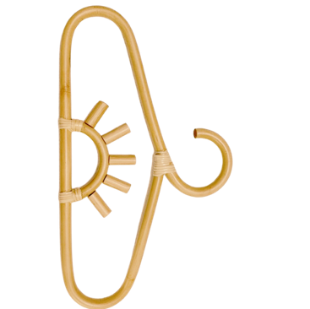
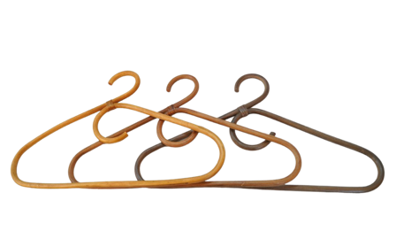
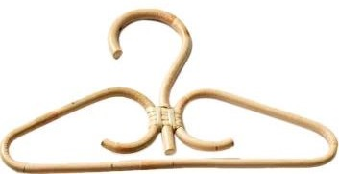
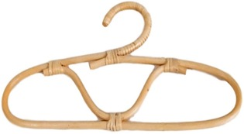
VC17RA621037
VC17RA621034
VC17RA621038
VC17RA621052
VC17RA621039
VC17RA621044
Song Collection - Viet Creative Art

Slide 4
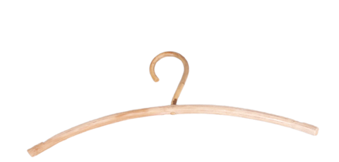
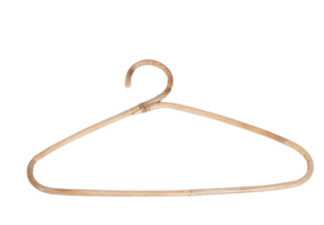
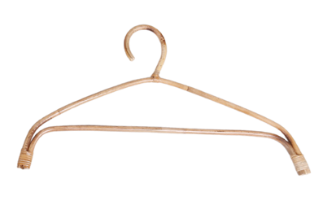
VC17RA621040
VC17RA621041
VC17RA621054
VC17RA621057
VC17RA621056
VC17RA621055
Song Collection - Viet Creative Art

Slide 5
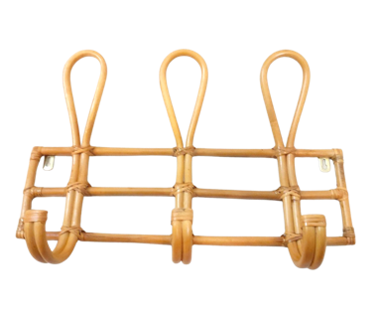
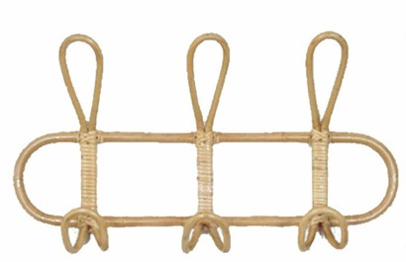
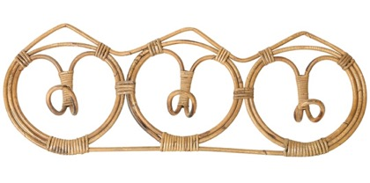
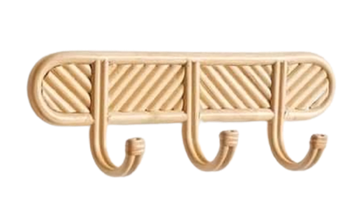
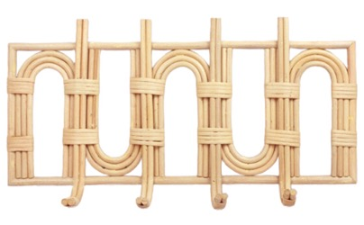
VC17RA621036
VC17RA621051
VC17RA621042
VC17RA621020
VC17RA621048
Song Collection - Viet Creative Art

Slide 6
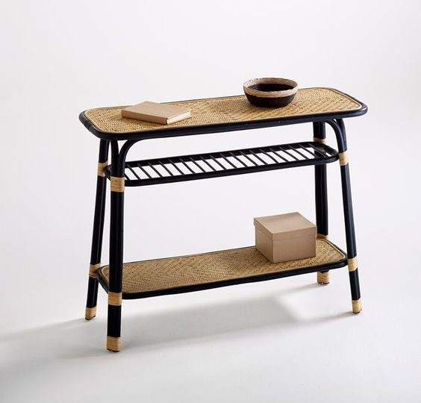
SHELF
Song Collection - Viet Creative Art

Slide 7
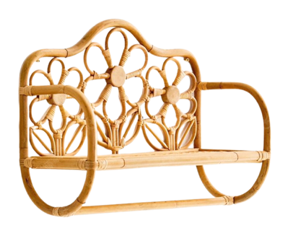
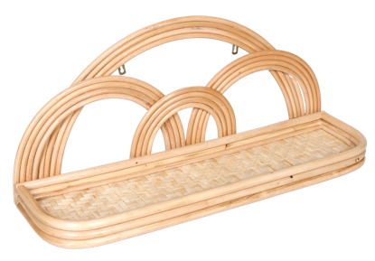
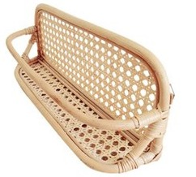
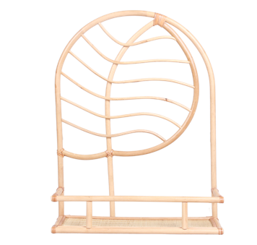
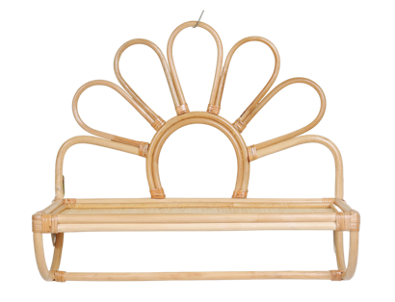
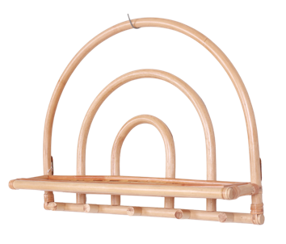
VC17RA621046
VC17RA621003
VC17RA621047
VC17RA621027
VC17RA621028
VC17RA621029
Song Collection - Viet Creative Art

Slide 8
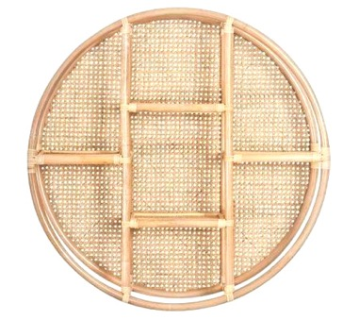
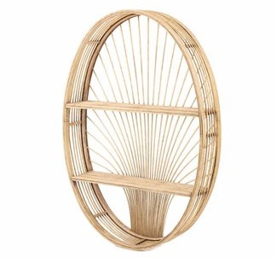
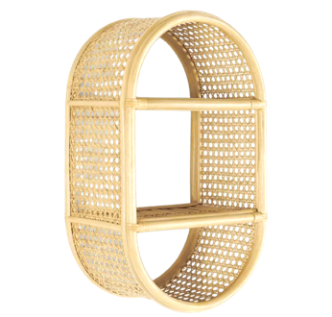
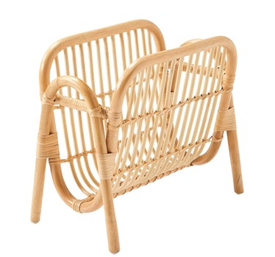
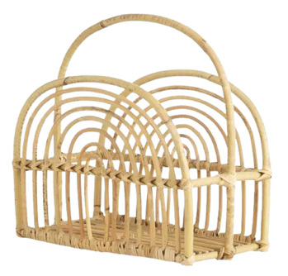
VC12RA621022
VC12RA621023
VC12RA621032
VC12RA621019
VC12RA621024
VC12RA621025
Song Collection - Viet Creative Art

Slide 9
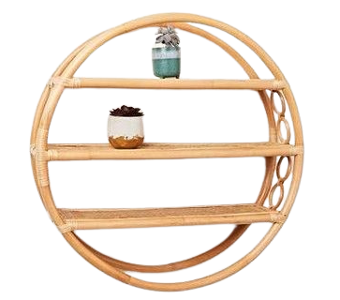
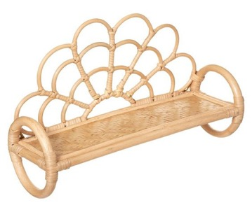
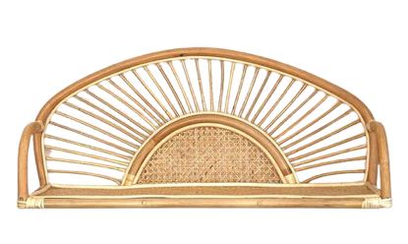
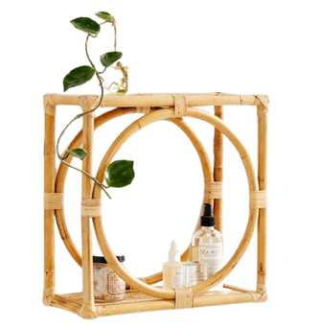
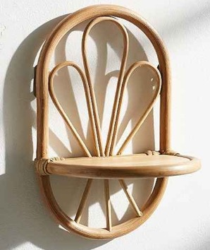
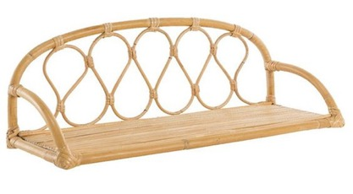
VC17RA621043
VC12RA621030
VC17RA621050
VC17RA621045
VC12RA621029
VC17RA621049
Song Collection - Viet Creative Art

Slide 10
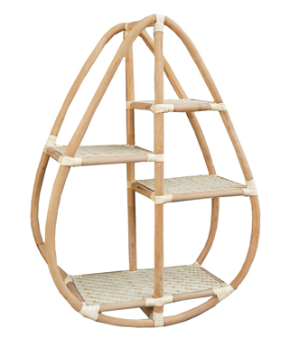
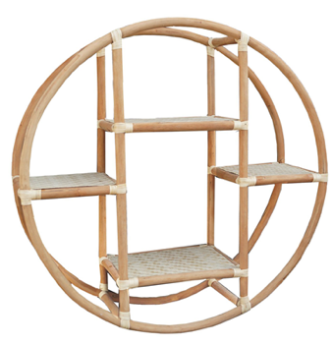
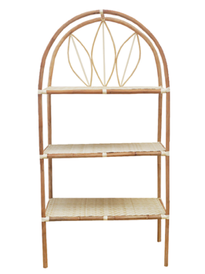
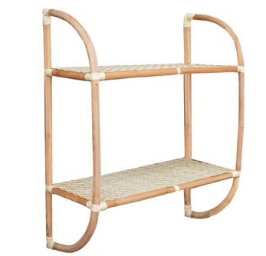
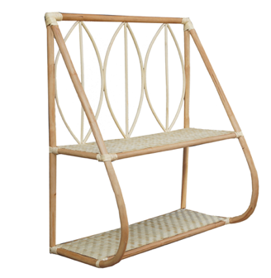
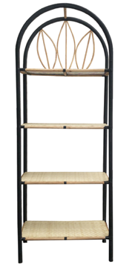
VC12RA621012
VC12RA621013
VC12RA621007
VC12RA621009
VC12RA621008
VC12RA621010
Song Collection - Viet Creative Art

Slide 11
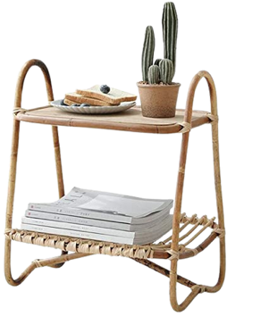
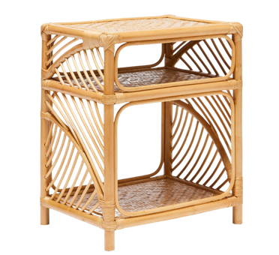
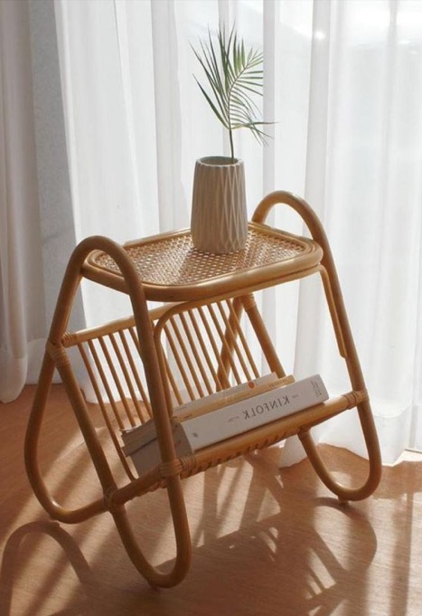
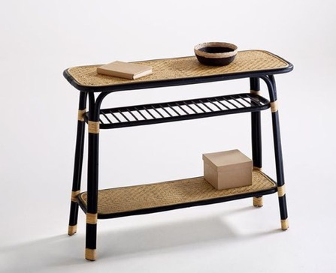
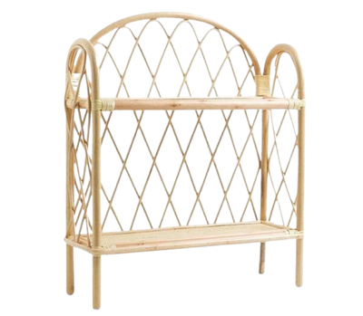
VC12RA621031
VC12RA621021
VC12RA621027
VC12RA621026
VC12RA621028
Song Collection - Viet Creative Art

Slide 12
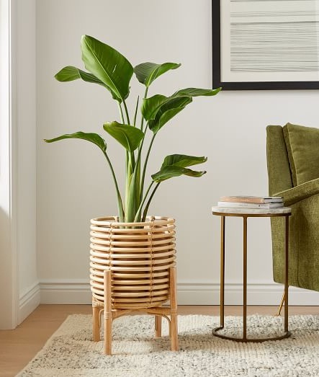
PLANTER
Song Collection - Viet Creative Art

Slide 13
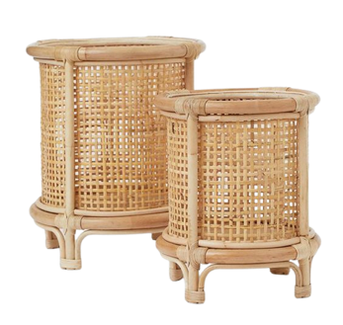
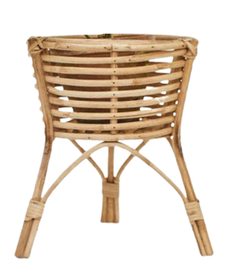
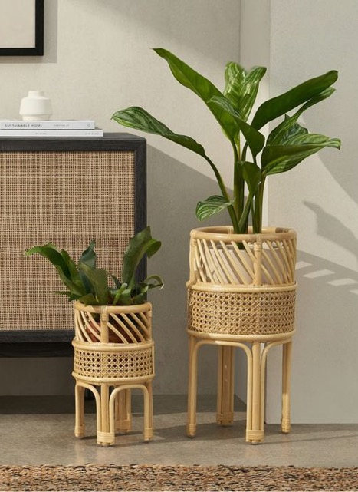
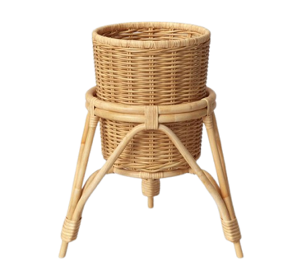
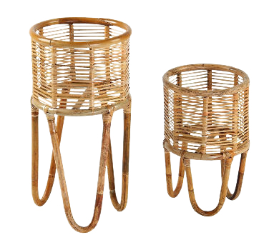
VC10RA721003
VC10RA621007
VC10RA621005
VC10RA421001
VC10RA621010
Song Collection - Viet Creative Art

Slide 14
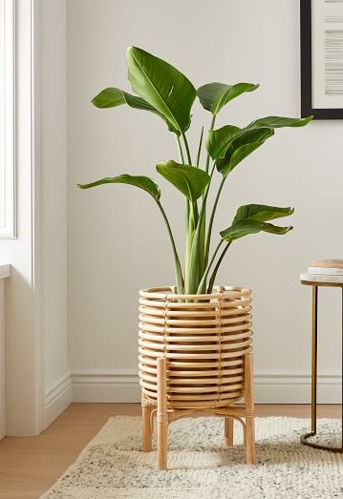
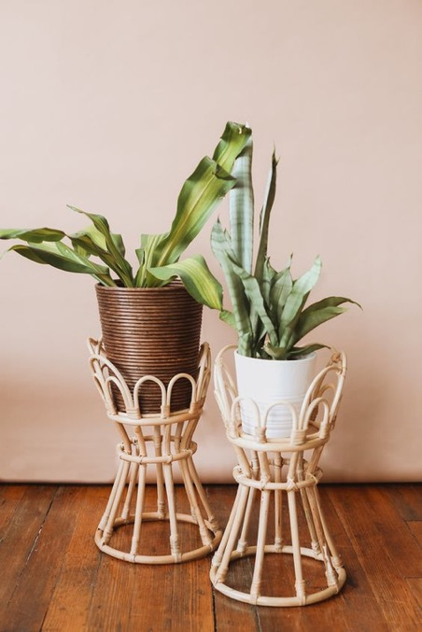
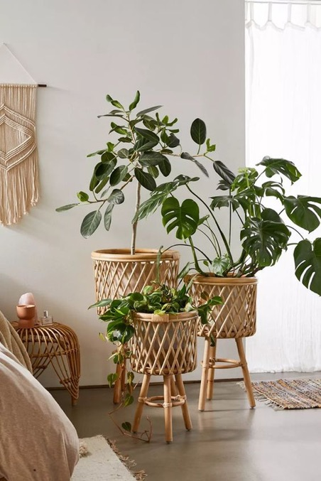
VC10RA621011
VC10RA621009
VC10RA621012
Song Collection - Viet Creative Art

Slide 15
THANK YOU !
Contact person: Linh Kim
Email: Linh.kim@vietcreativecraft.com

