Slide 1
PHOTO FRAME COLLECTION
Viet Creative Art Co., Ltd
June 2021

Slide 2
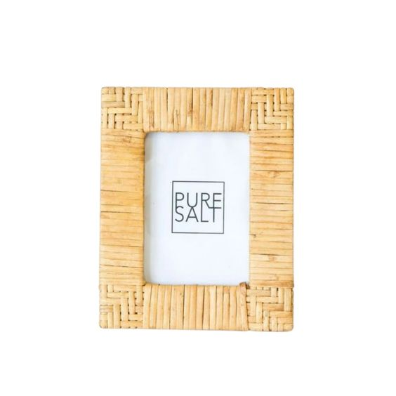
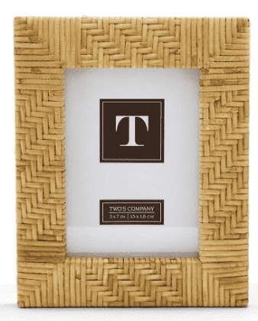
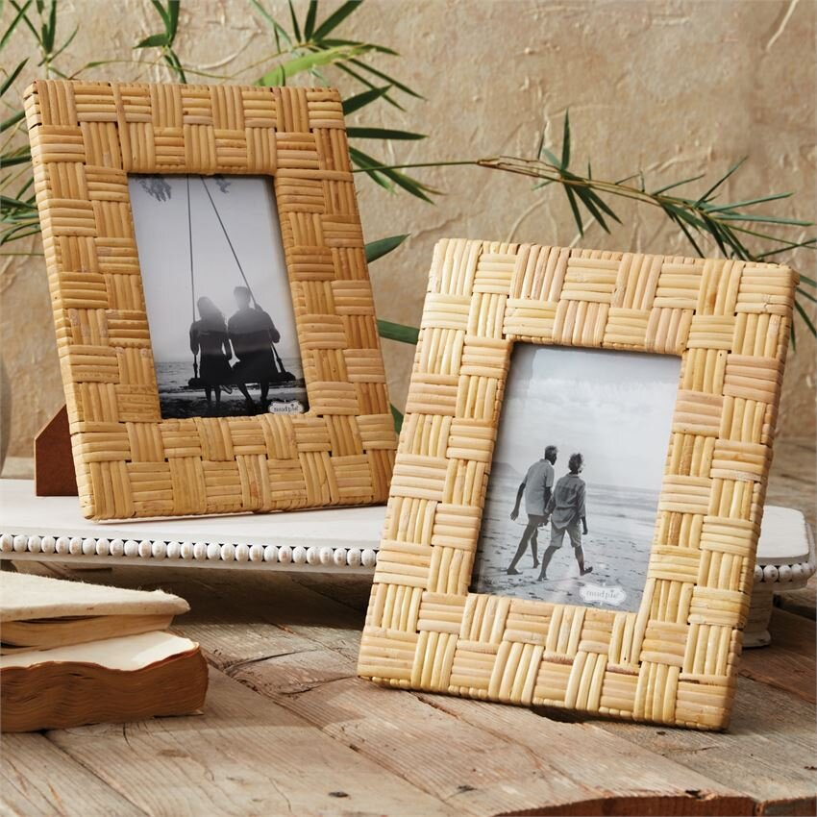
RATTAN PHOTO FRAME
VC20RA721001
VC20RA721002
VC20RA721003

Slide 3
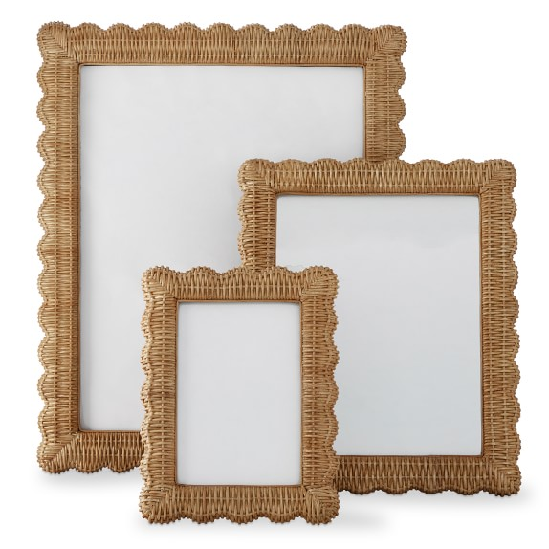
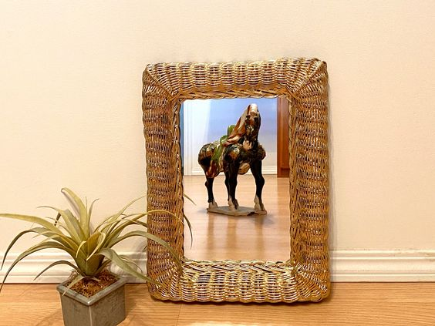
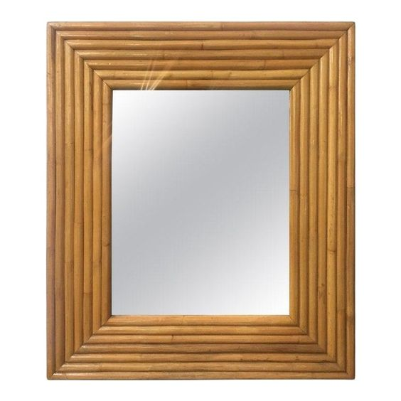
RATTAN PHOTO FRAME
VC20RA121001
VC20RA121002
VC20RA621001

Slide 4
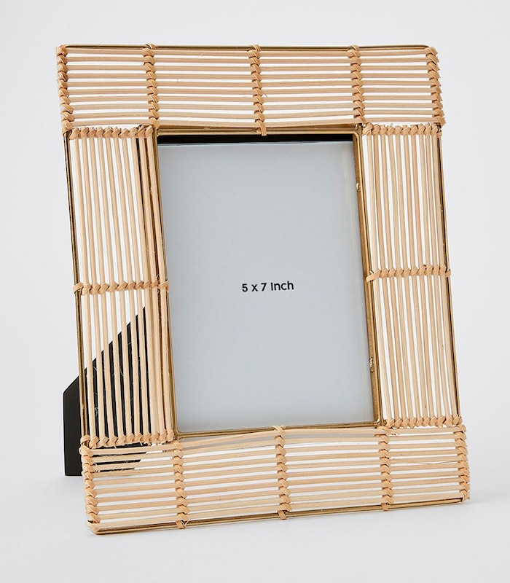
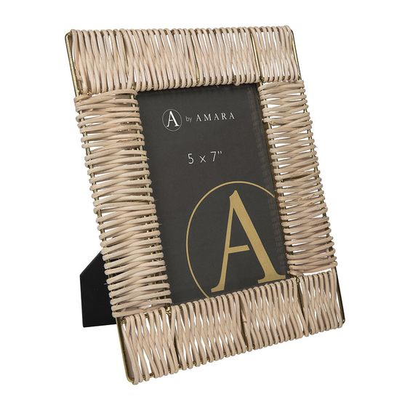
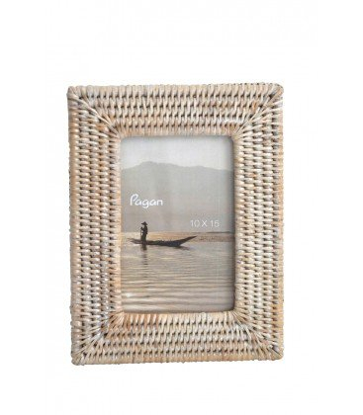
RATTAN PHOTO FRAME
VC20RA721004
VC20RA721005
VC20RA421001

Slide 5
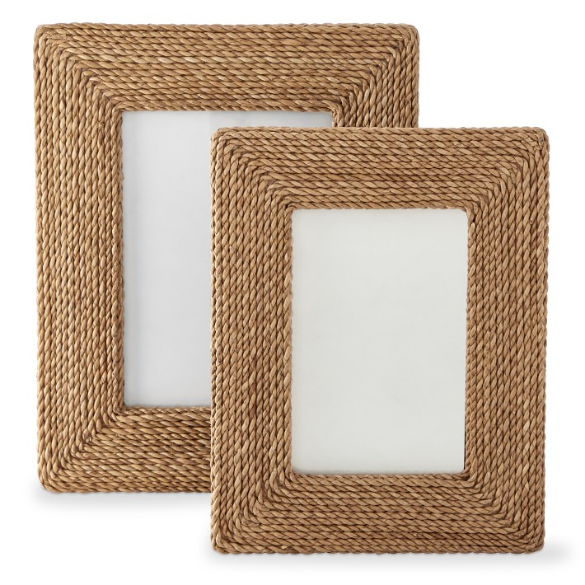
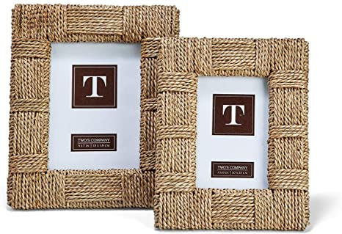
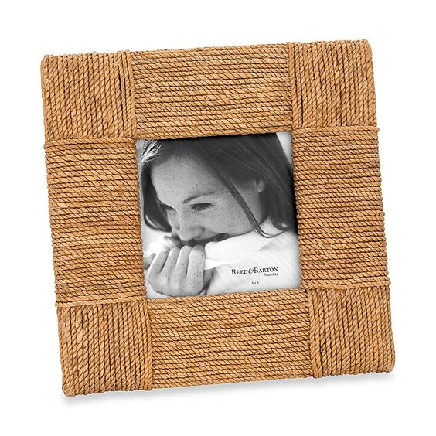
SEAGRASS PHOTO FRAME
VC20SE121001
VC20SE121002
VC20SE121003

Slide 6
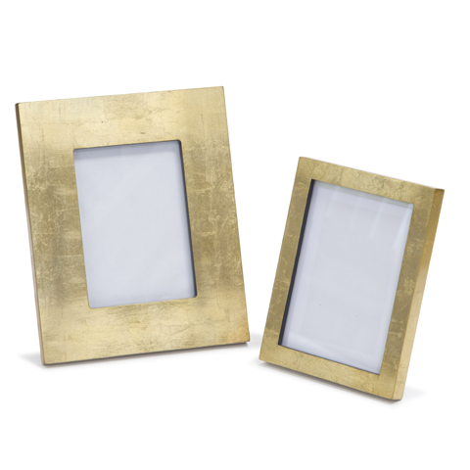
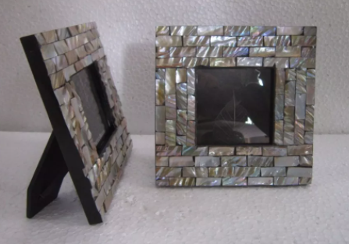
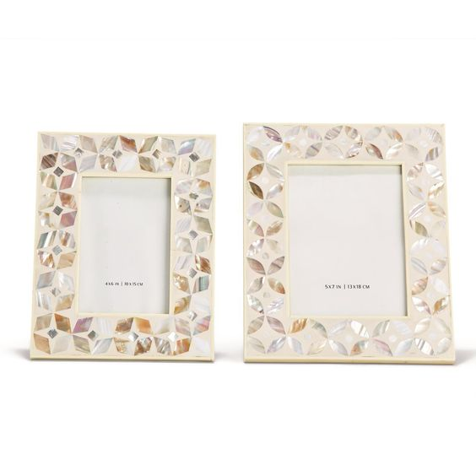
LACQUER PHOTO FRAME
VC20LA121001
VC20LA321001
VC20LA321002

Slide 7
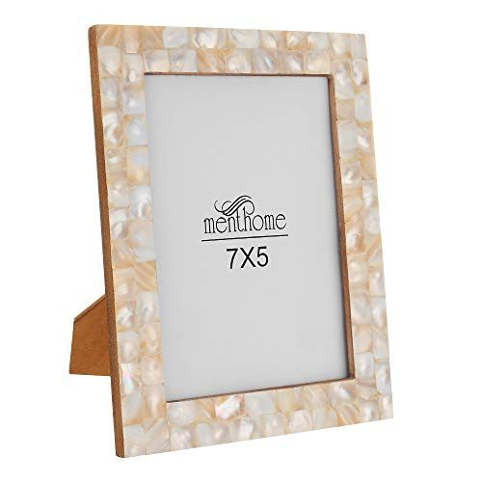
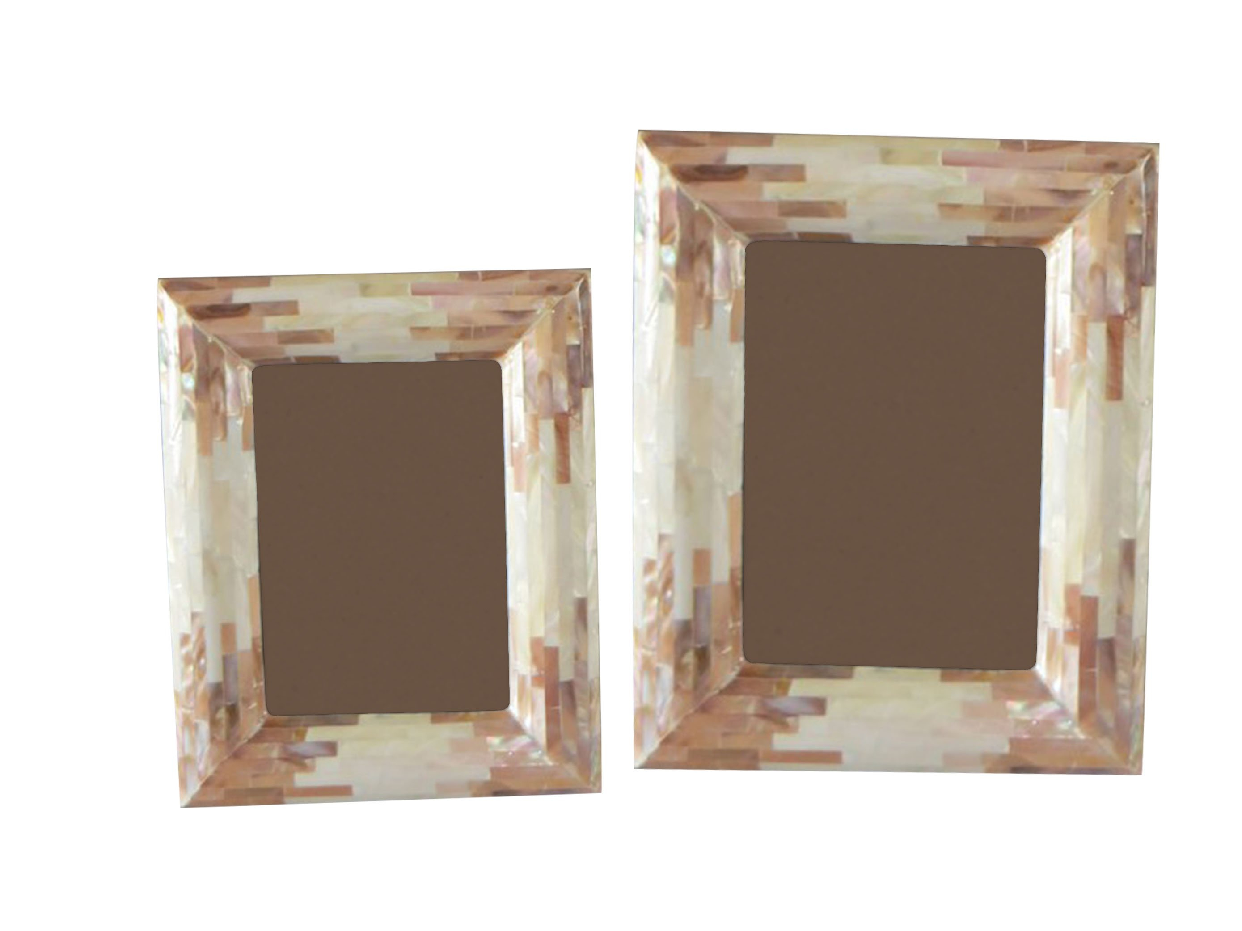
LACQUER PHOTO FRAME
VC20LA321003
VC20LA321004

Slide 8
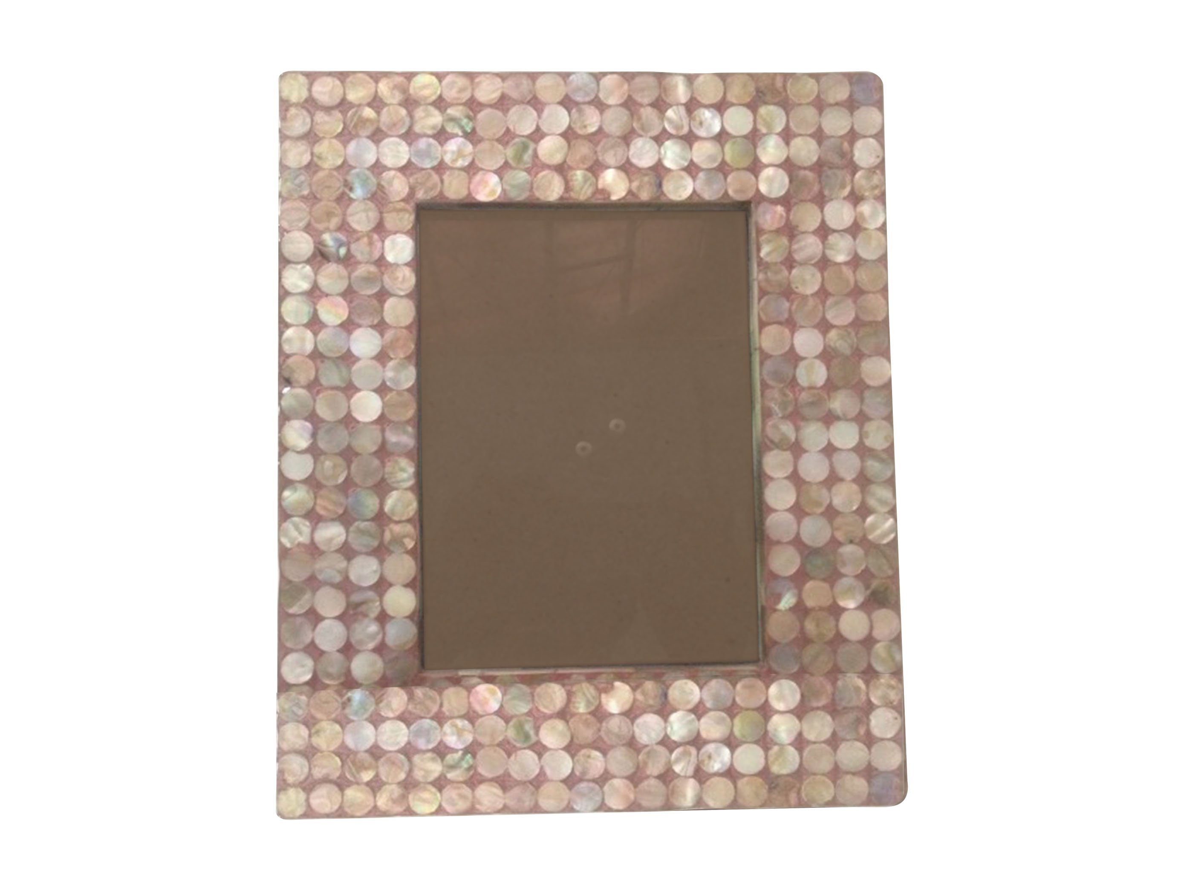
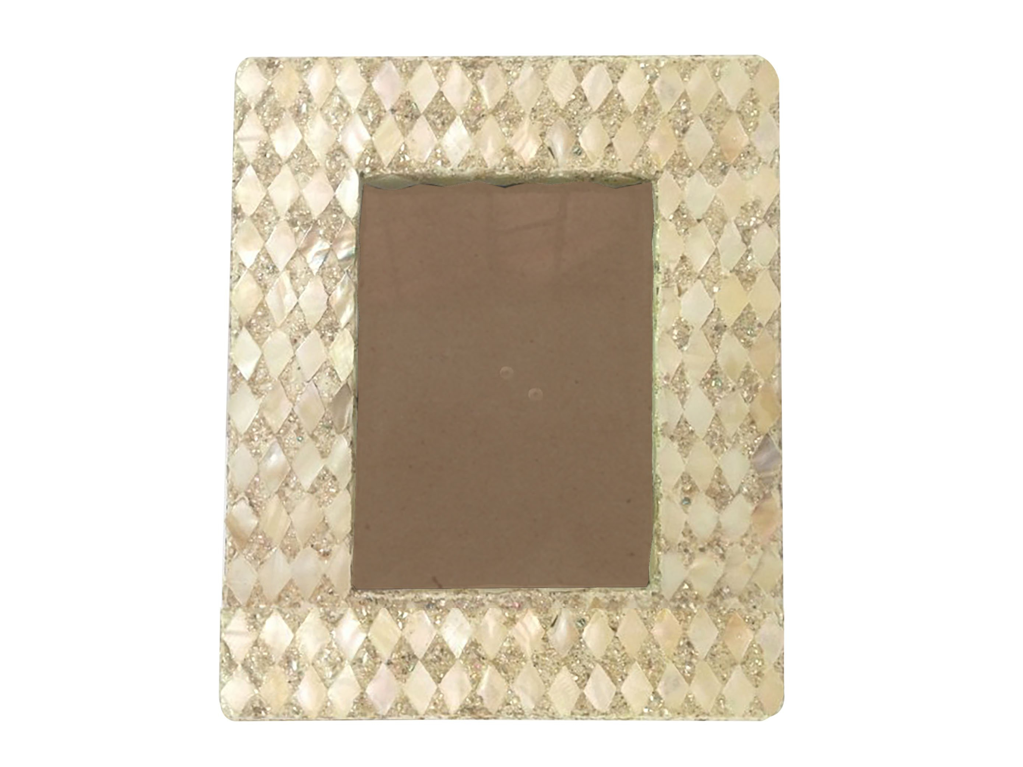
LACQUER PHOTO FRAME
VC20LA321005
VC20LA321006

Slide 9
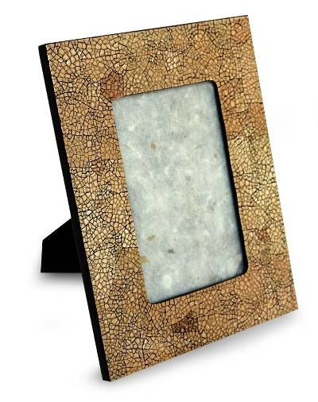
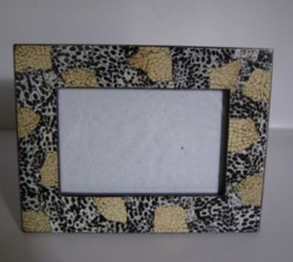
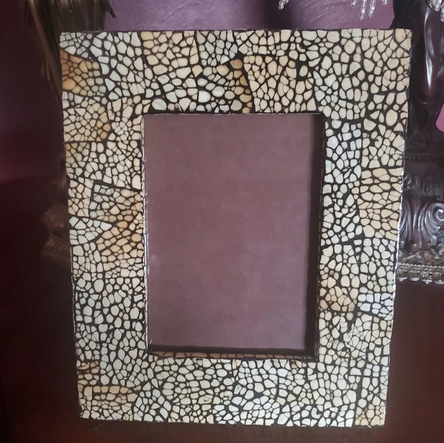
LACQUER PHOTO FRAME
VC20LA221001
VC20LA221002
VC20LA221003

Slide 10
THANK YOU
Contact person: Linh Kim
Email: linh.kim@vietcreativecraft.com

